Slide 1
Preparing to Preserve
John O’Herron

Slide 2
Preservation: A brief 8 a.m. History
1821
There can be no doubt that this question passed sub silentio in the Court below, but it does not appear from any thing on the record, that the point was waived; and we are not at liberty to look beyond the record for the evidence.
Kerr v. Watts, 19 U.S. 550, 561-62 (1821).

Slide 3
2008
When there are both preserved and unpreserved errors, cumulative-error analysis should proceed as follows: First, the preserved errors should be considered as a group under harmless-error review. If, cumulatively, they are not harmless, reversal is required. If, however, they are cumulatively harmless, the court should consider whether those preserved errors, when considered in conjunction with the unpreserved errors, are sufficient to overcome the hurdles necessary to establish plain error. In other words, the prejudice from the unpreserved error is examined in light of any preserved error that may have occurred. For example, the defendant may not be able to establish prejudice from the cumulation of all the unpreserved errors, but factoring in the preserved errors may be enough for the defendant to satisfy his burden of showing prejudice. If so, the fourth prong of plain-error review must then be examined. United States v. Caraway, 534 F.3d 1290, 1302 (10th Cir. 2008).

Slide 4
Motions in Limine – Fed. R. Evid. 103
Substantial right of the party?
Ruling admitting evidence?
- on the record
- timely
- specificity, or “apparent from the context”
Ruling excluding evidence?
- offer of proof, or “apparent from the context”?
Do you need to renew?
- did court rule “definitively” and on the record?

Slide 5
Complexity in Preservation
Motions in limine you win
Motions in limine that you lose
Motions for summary judgment
Jury selection challenges
Improper argument
Admissibility of evidence
Jury instructions and verdict forms
Sufficiency of the evidence
Motions for Judgment as a matter of law
Post-verdict motions

Slide 6
Reframing Preservation
Protecting our right to complain
Building the legal foundation for victory
Using an appellate lens

Slide 7
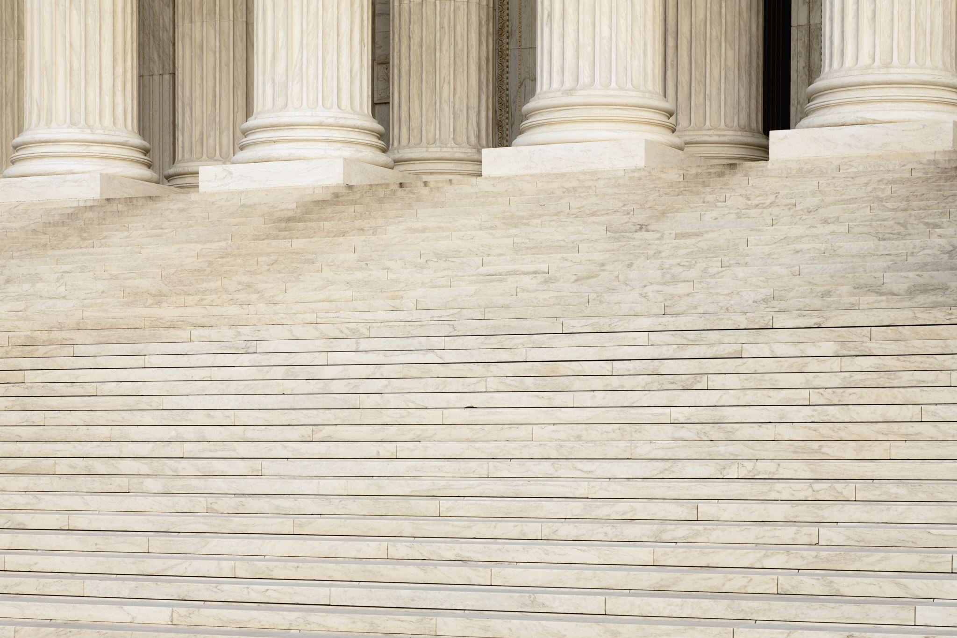
Protecting our right to complain
Primary goal: to win at trial.
Secondary goal: to win on appeal.
What steps here will protect my complaint there?

Slide 8
Building a foundation for victory
Law needed to win:
Pre-trial
Trial
Post-trial

Slide 10
Using an appellate lens
Appellate considerations
Standard of Review
Record only
The next case
At every stage: how do these impact the legal case I am building?

Slide 11
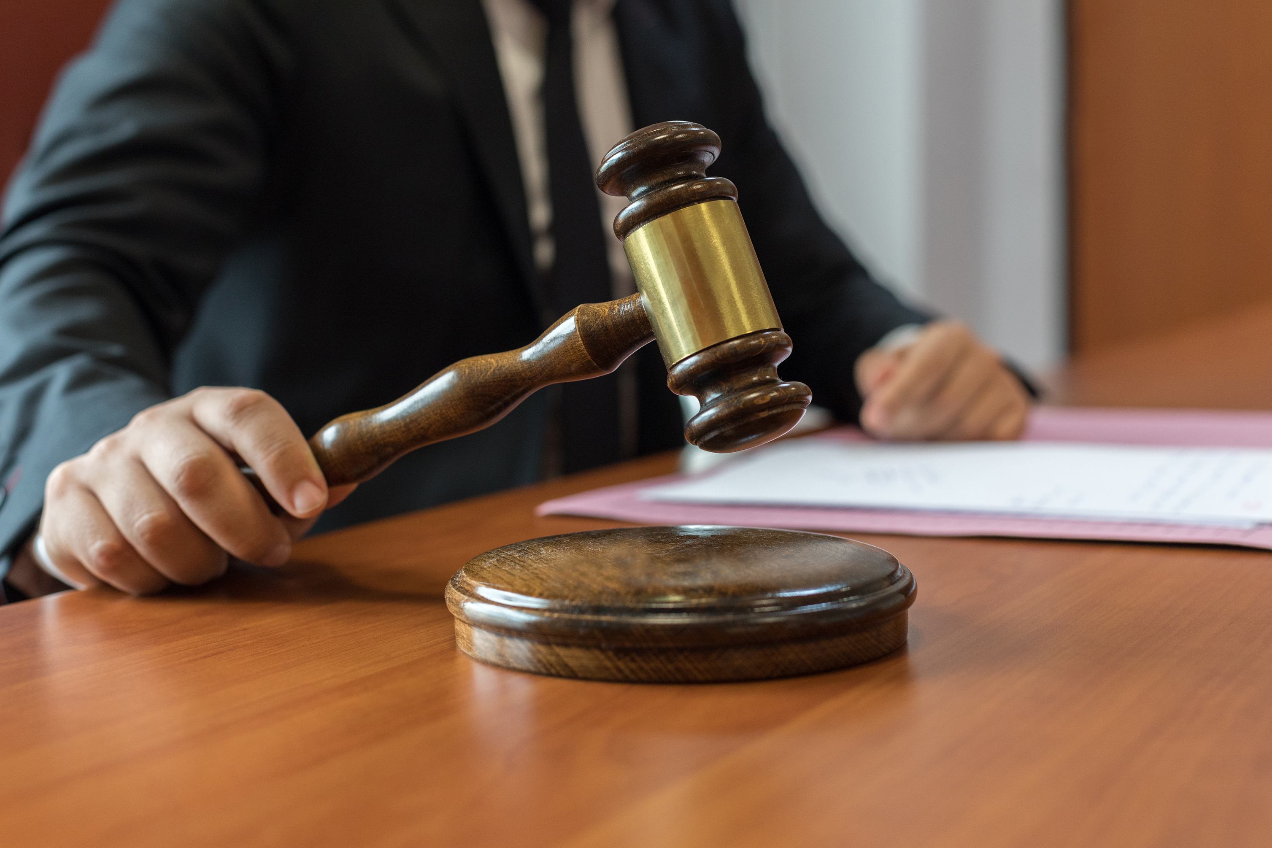
Basics of Preservation
To correct error, appellate court needs you to:
Make a specific objection or argument on record;
When the error can be corrected; and
Obtain a ruling.

Slide 12
John P. O’Herron
joherron@t-mlaw.com
804-698-6253
Richmond, VA

